Slide 1
VG Development – Unity Basics
Interactive Media
Unit 1

Slide 2
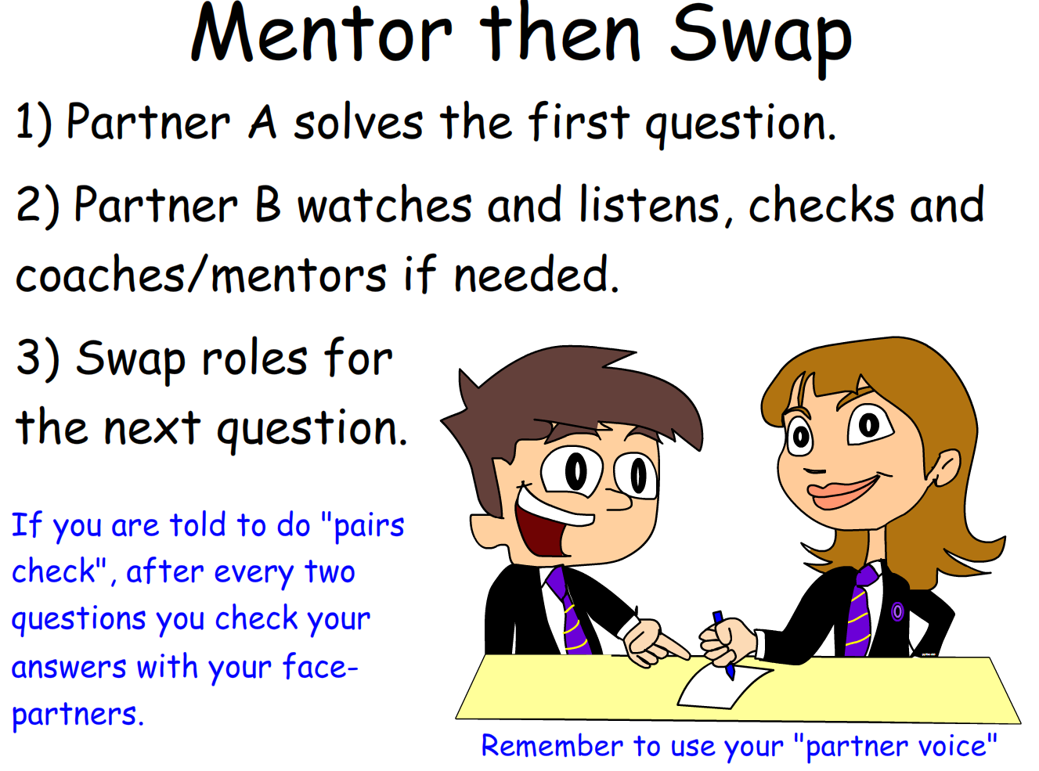
Starter – 5 Minutes
Log in and fill your answers into your worksheet.
What problems could arise from an incomplete/untested game?
What are the benefits of a team working on a game rather than just one person?

Slide 3

Learning Outcomes
Aspire to ……
 | Explain the advantages and disadvantages of using a tool such as Unity to produce a VG.
Challenge to……
 | Describe the skills required to create a full VG.
 | Understand the basics of using Unity to produce a VG.

Slide 4
Working with Unity
When working with Unity, you will be mainly using one of two pieces of software:
Unity
An IDE e.g. Visual Studio
As such, you will need to learn how to use both well enough to produce a VG.

Slide 5

Unity Programming
Unity uses a member of the C-family of programming languages; C# (C sharp).
Although you’ll find that some of the code shares similarities with Python, the syntax (the grammar) is different.
What do you think the following code does?

Slide 6
Learning Unity
The purpose of this unit is to allow you to experiment with different software in order to produce an interactive media product.
You have been given access to two tutorials.
These explain the basics of producing a 2D, then a 3D game in Unity.
From there, you can then adapt and change the games in order to fit your needs.

Slide 7

Task 1 – Unity Demo
The following demonstration is of a simple platformer-style game made in Unity. Note down your answers in the worksheet.
What part do you think took the longest to make?
Explain why you think that is.
How long do you think it took to make this? Explain your reasoning.
Do you think this game is complete? Why?
Challenge D

Slide 8
Example Project – Demo
Do you think this game is complete? No
How long do you think it took to make this? 3-4 Hours
What part do you think took the longest? The floor-placing code

Slide 9
Task 2 – Tutorials
You have been provided with two tutorials; one for 2D game development and the other for 3D. You must complete the 2D tutorial first to move on to the 3D.
Experiment with the code in both, adapt it to how you like.
What else would you like to add but can’t just yet?
Move on to the 3D tutorial after the 2D.
Work your way through the 2D tutorial.
Challenge D

